Slide 1
Payment Options for today’s Thrift and Gift Stores
Kamloops, April 4-6 2022
Karen Noon
Sunshine Coast Healthcare Auxiliary

Slide 2
In the US, 9300 retail stores closed their doors in 2019. The trend is similar in Canada, to name a few:
Zellers
Sears
Home Outfitters
Victoria’s Secret
Kmart
¿¿¿¿What were these stores doing wrong????
They did not meet their customers’ needs nor keep up with today’s technology

Slide 3
Technology in our everyday lives.
Who has used recently?:
ATM
Debit card
Credit card
Email - Text
Smartphone or Smartwatch
Computer or tablet
Gets bills via email
Electronic funds transfer

Slide 4
Spending statistics
70% prefer card payments over cash (54% use debit cards 26% credit cards)
This is mainly due to the convenience but also because it is the NORM for retailers to accept them
Mobile payments are experiencing rapid growth
More consumers will be using mobile payments for in-store retail
It is projected that by 2024, cash will account for less than 10% of in-store purchases

Slide 5
Why accept other payment methods ?
To keep pace with consumers and competitors
Give your store authenticity
Increase your sales!
Deposit to your bank account automatically, faster and accurately

Slide 6
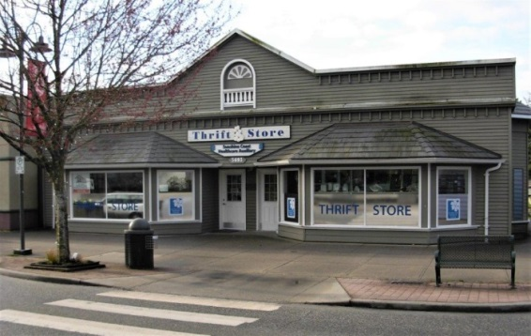
Sunshine Coast Healthcare Auxiliary Thrift Store
Annual sales pre-pandemic $600,000 (growth ~10% per year)
Only one cash register
Open 10 - 3, 5 days per week
Started accepting credit and debit 6 years ago
Purchased “The Square” for use in offsite sales
Upgraded POS machine 3 years ago to accept tap and mobile payments
Minimum debit/credit payment accepted $5

Slide 7
Sales statistics from our store
Average 38-40% of monthly sales are run through POS system
Credit, debit and mobile payments.
Average $ transaction $7.83
210 to 330 transactions/day
Highest Sales/SqFt on the Sunshine Coast

Slide 8
E-payments cost vs. benefits
Average cost per transaction: is 1.5 to 3%
Benefits:
Customer convenience
50% of customers who cannot use preferred payment method abandon their purchase
Customers spend more when paying with credit/debit vs cash!
You may be leaving revenue unrealized
Customer security (tap feature)

Slide 9
New methods and technologies challenge our volunteers
Your staff may be hesitant, or even reluctant (demographics!)
Can you teach an old dog
new tricks? ☺

Slide 10
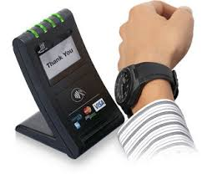
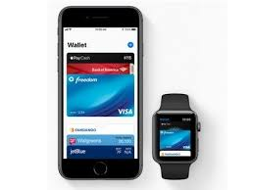
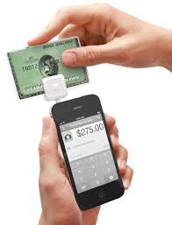
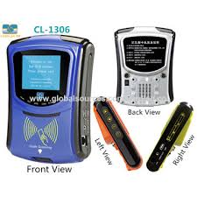
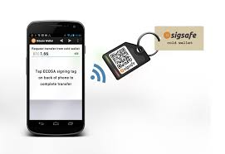
What we are seeing these days
iPhones
Google pay
Apple Pay
Apple Watch

Slide 11
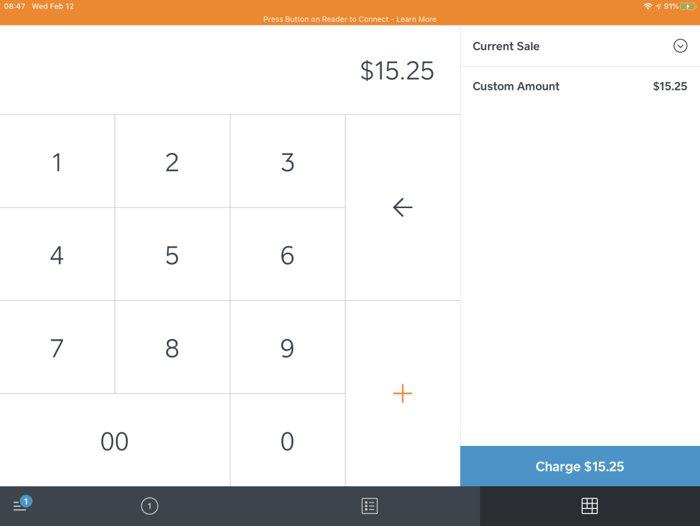
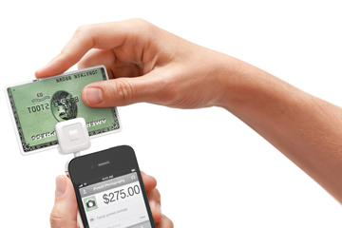
The Square
Point of sale system
Connect wirelessly to apple or android device (via Bluetooth)
Accept any type of payment (chip, pin, etc.)
Cost 2.56% for credit 10 cents per debit transaction
Take it anywhere

Slide 12
DO YOU WANT TO INCREASE YOUR BUSINESS?

Slide 13
QUESTIONS?
Thank you!
Дякую
谢
谢
Gracias
धन्यवादधन्यवाद
Vielen Dank
شكرا جزيلا
Merci
Grazie
Ευχαριστούμε

Slide 14
Social Media and YOU!
How to use social media to enhance your businesses.

Slide 15
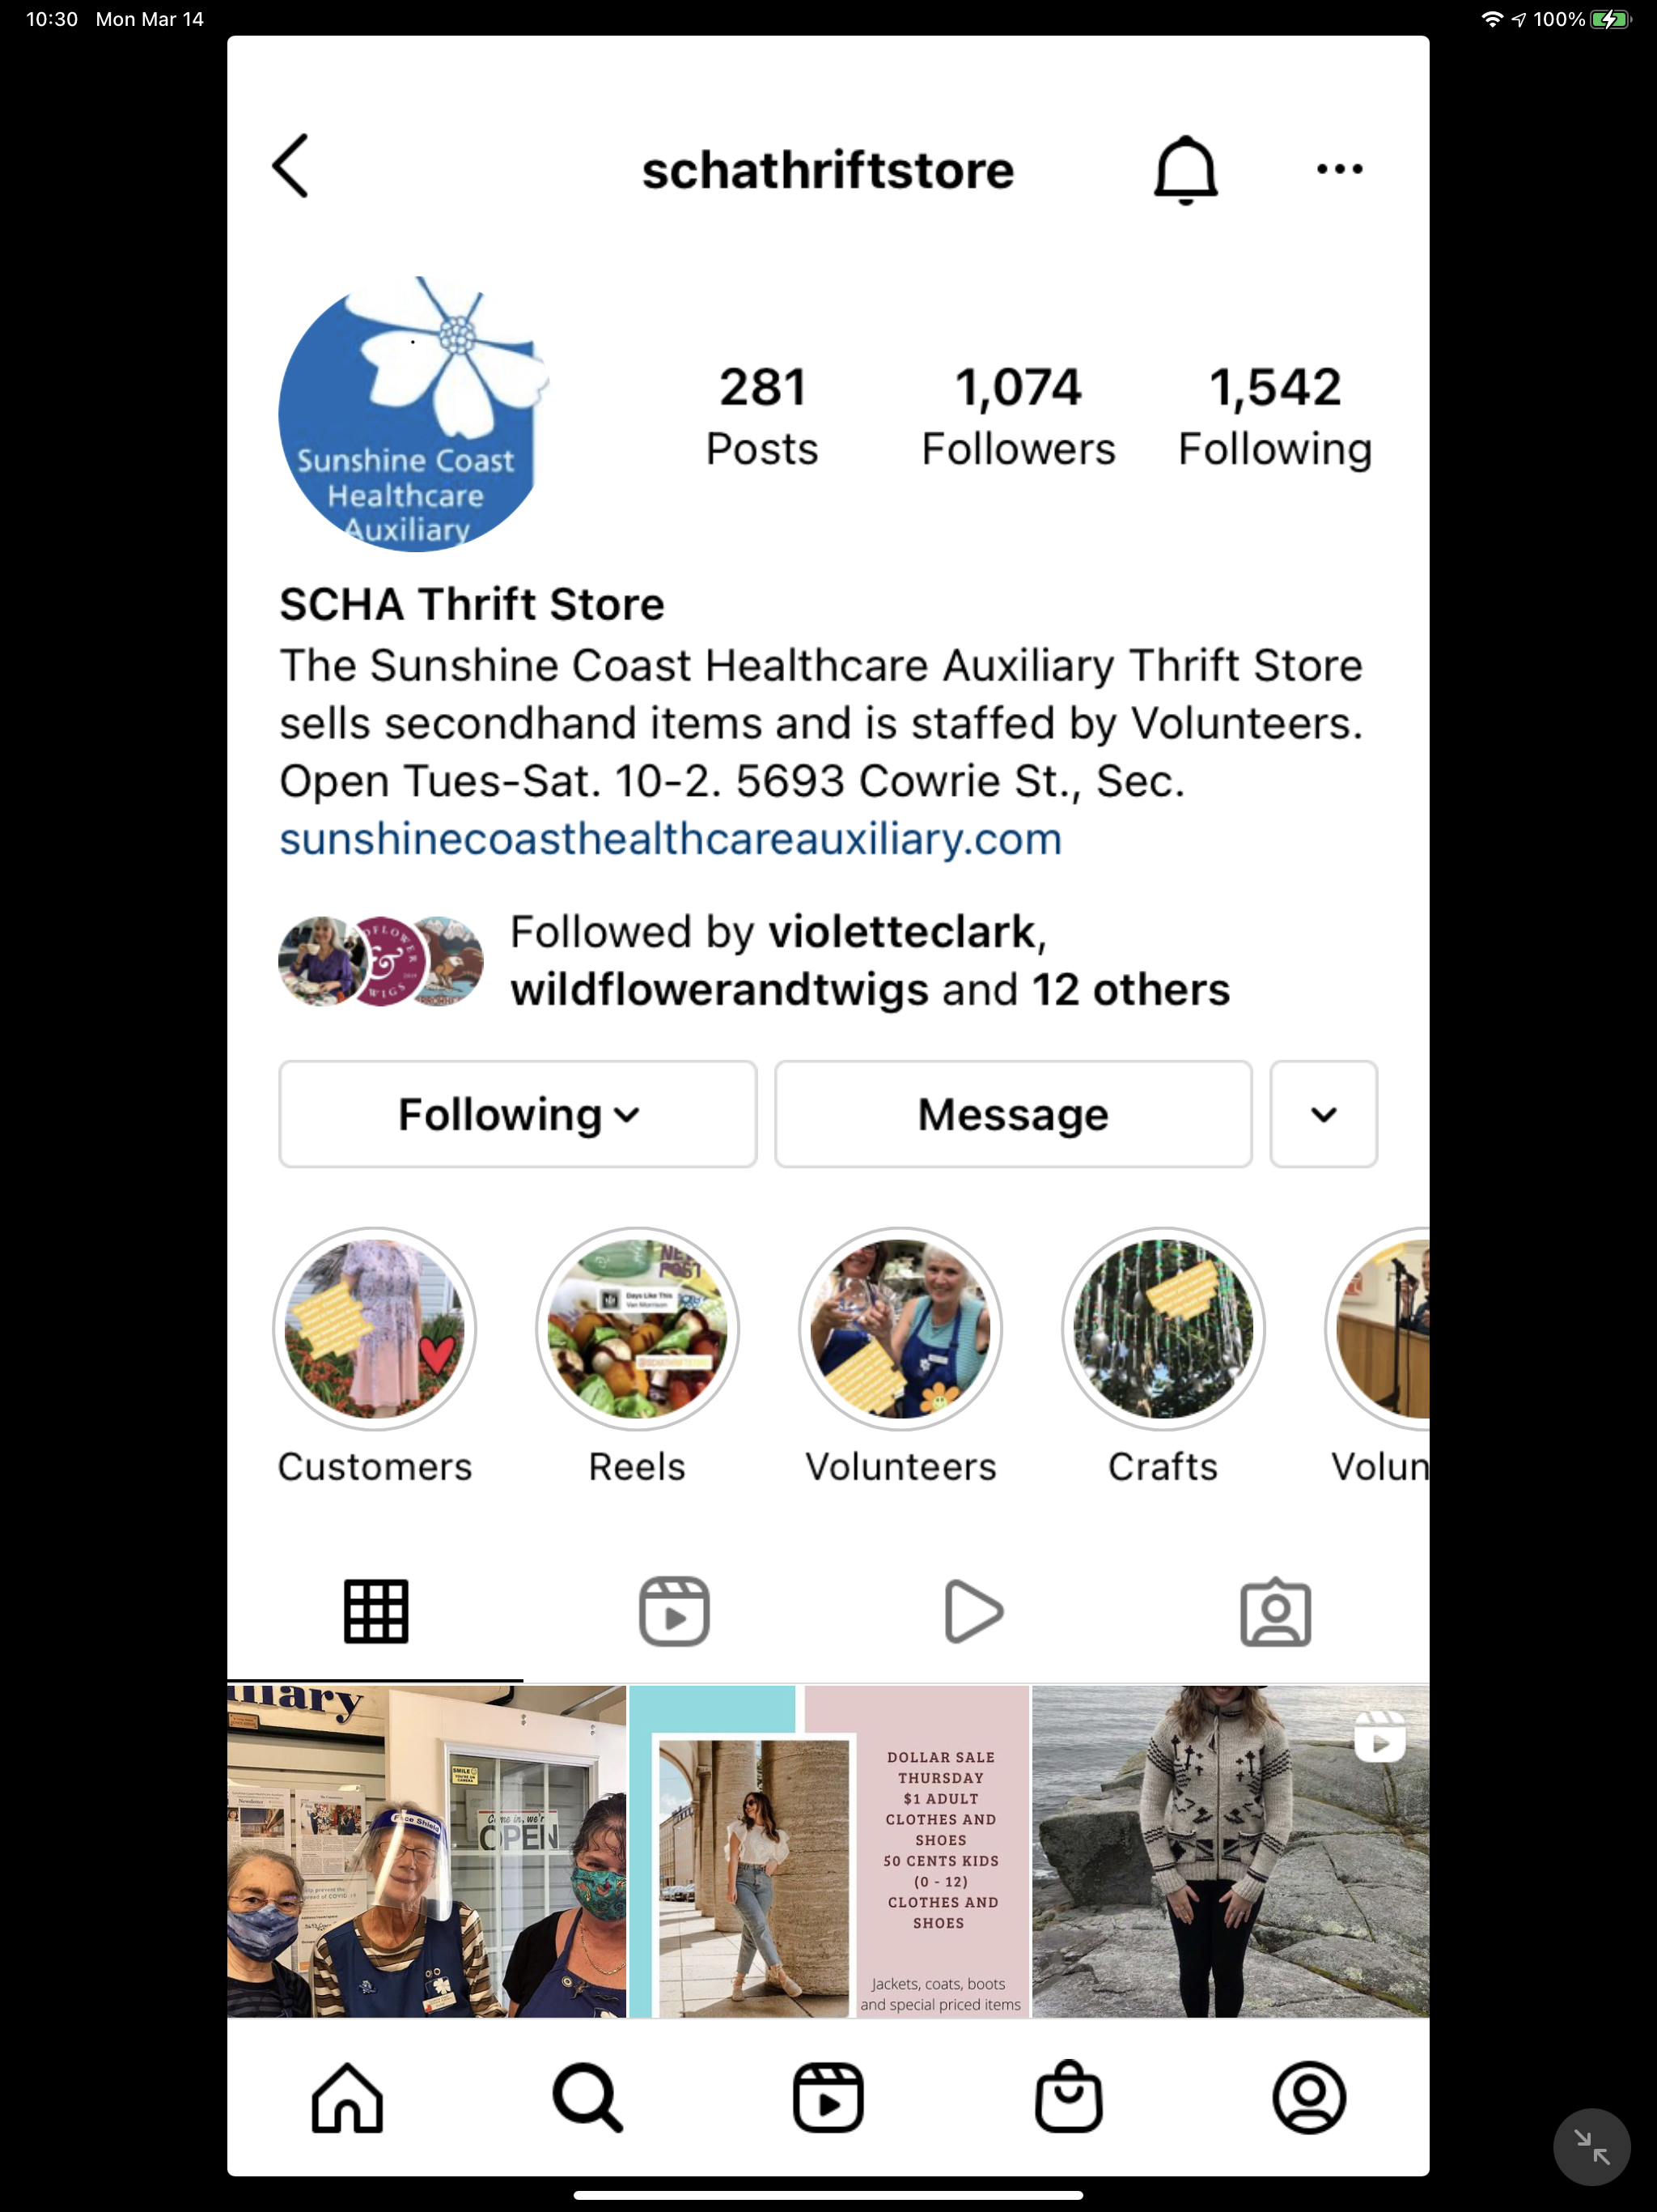
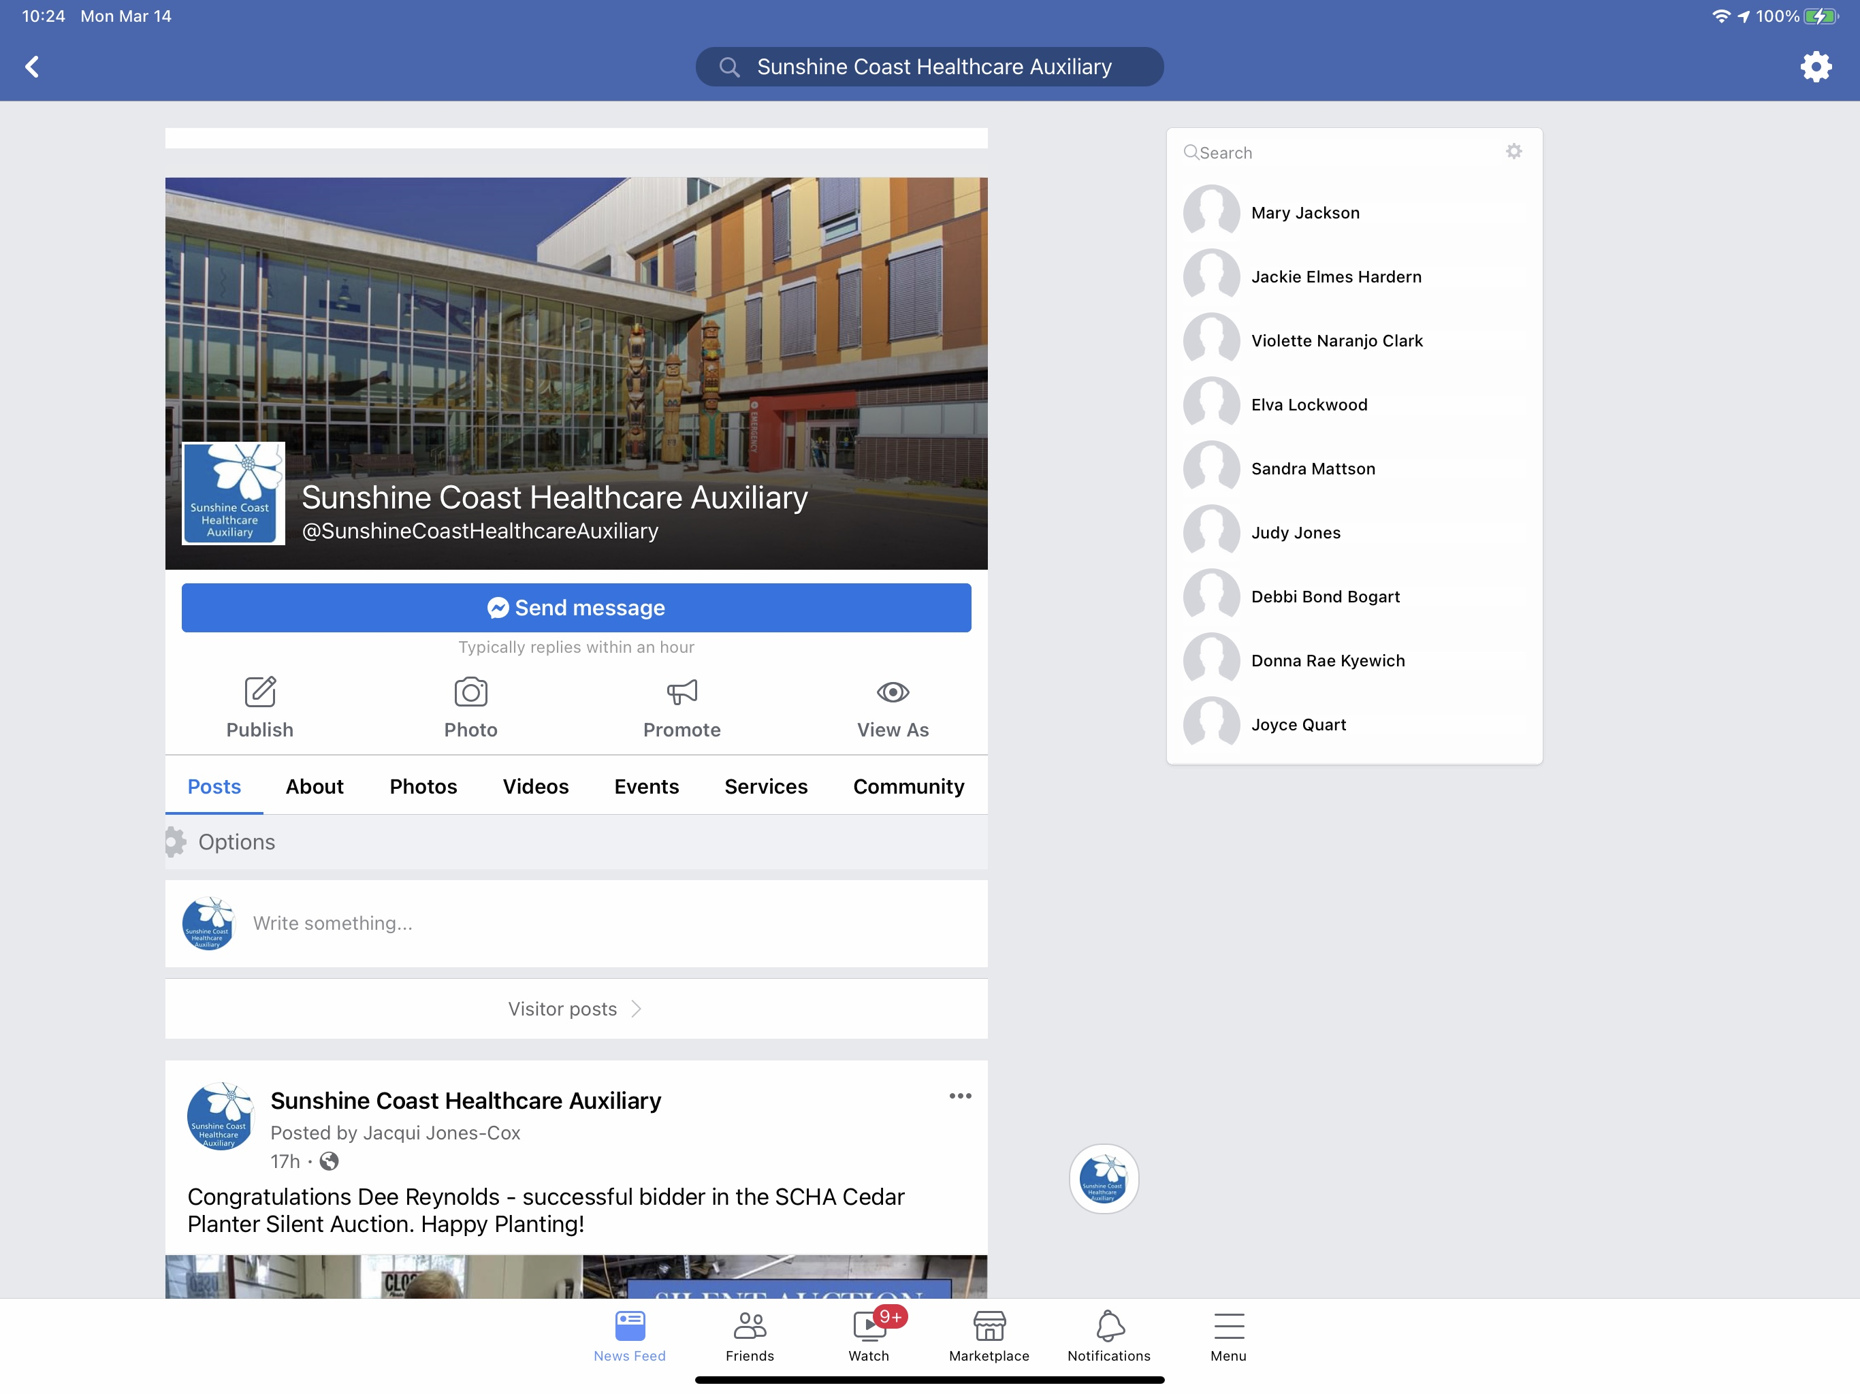
The Sunshine Coast Healthcare Auxiliary primarily uses Facebook, Instagram
and Twitter to reach our local community

Slide 16
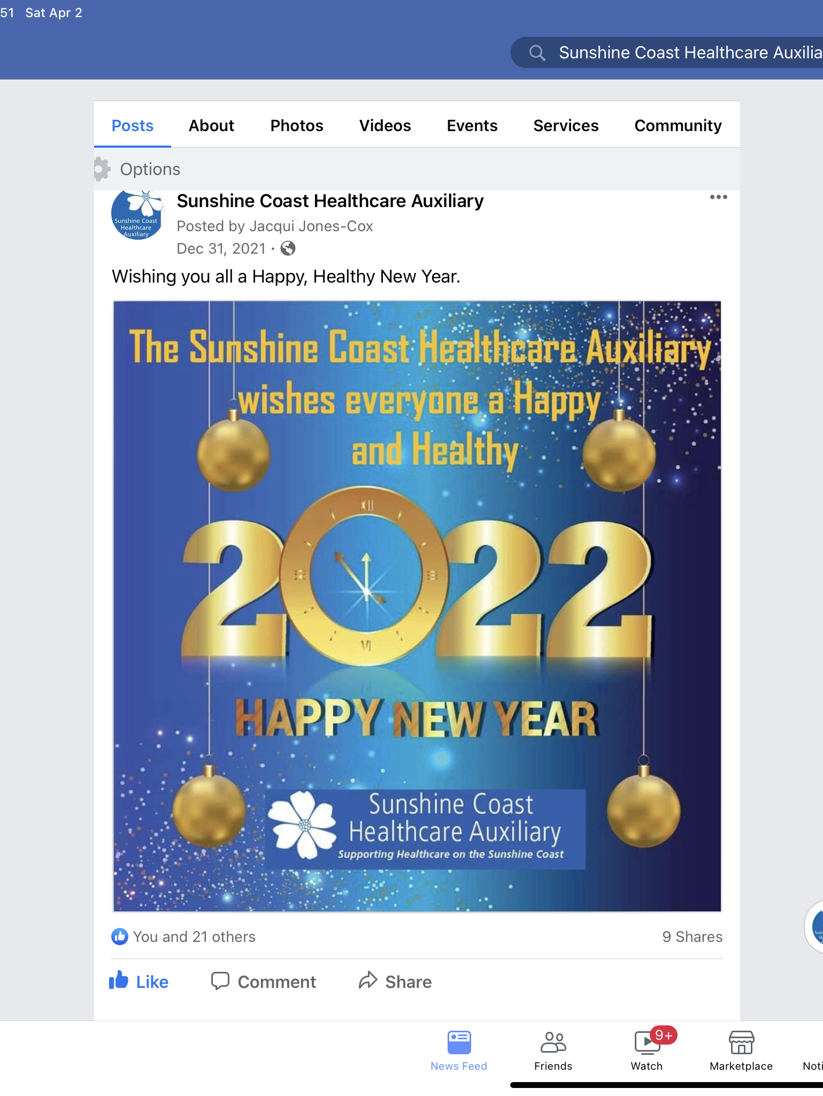
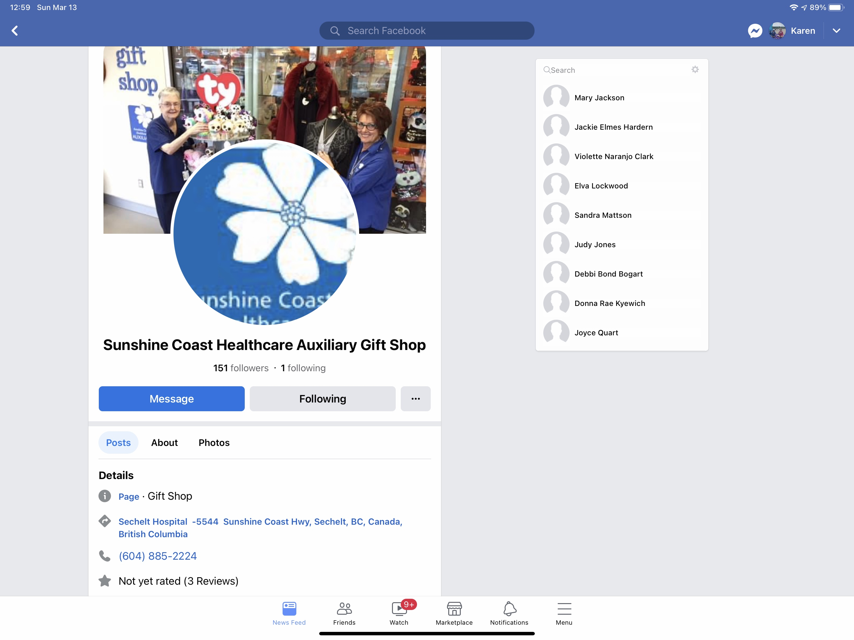
Using Social Media
Use Social Media for Advertising, Promotion and Information Sharing

Slide 17
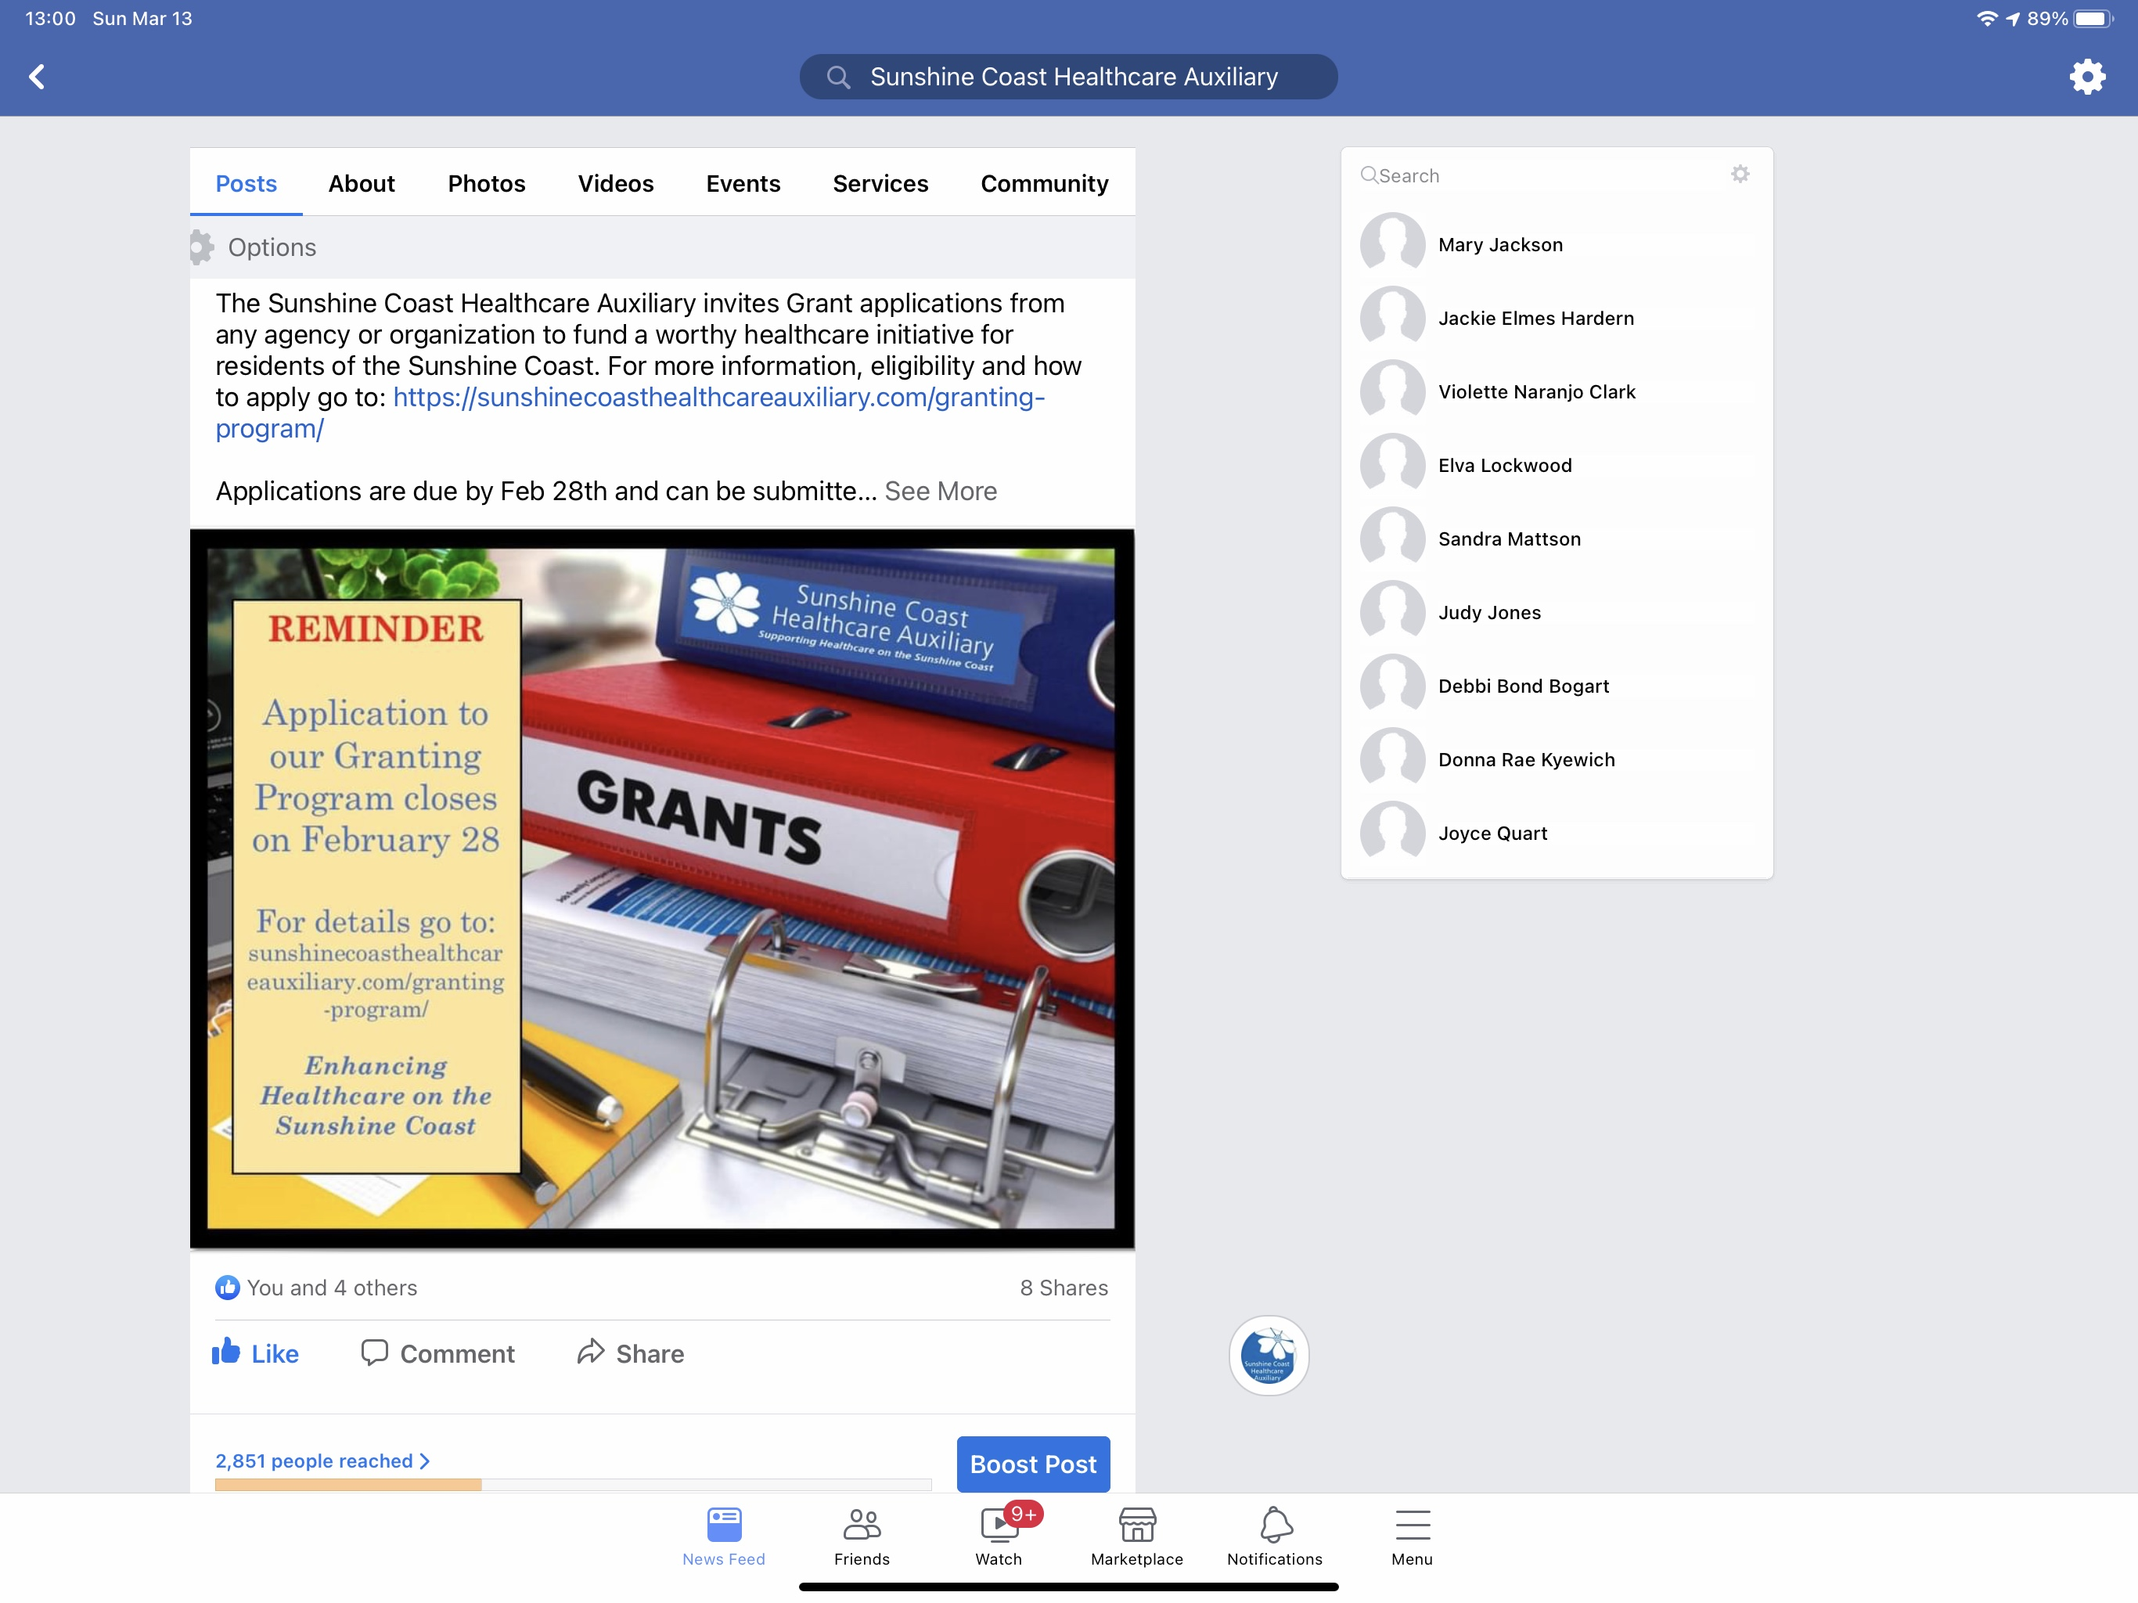
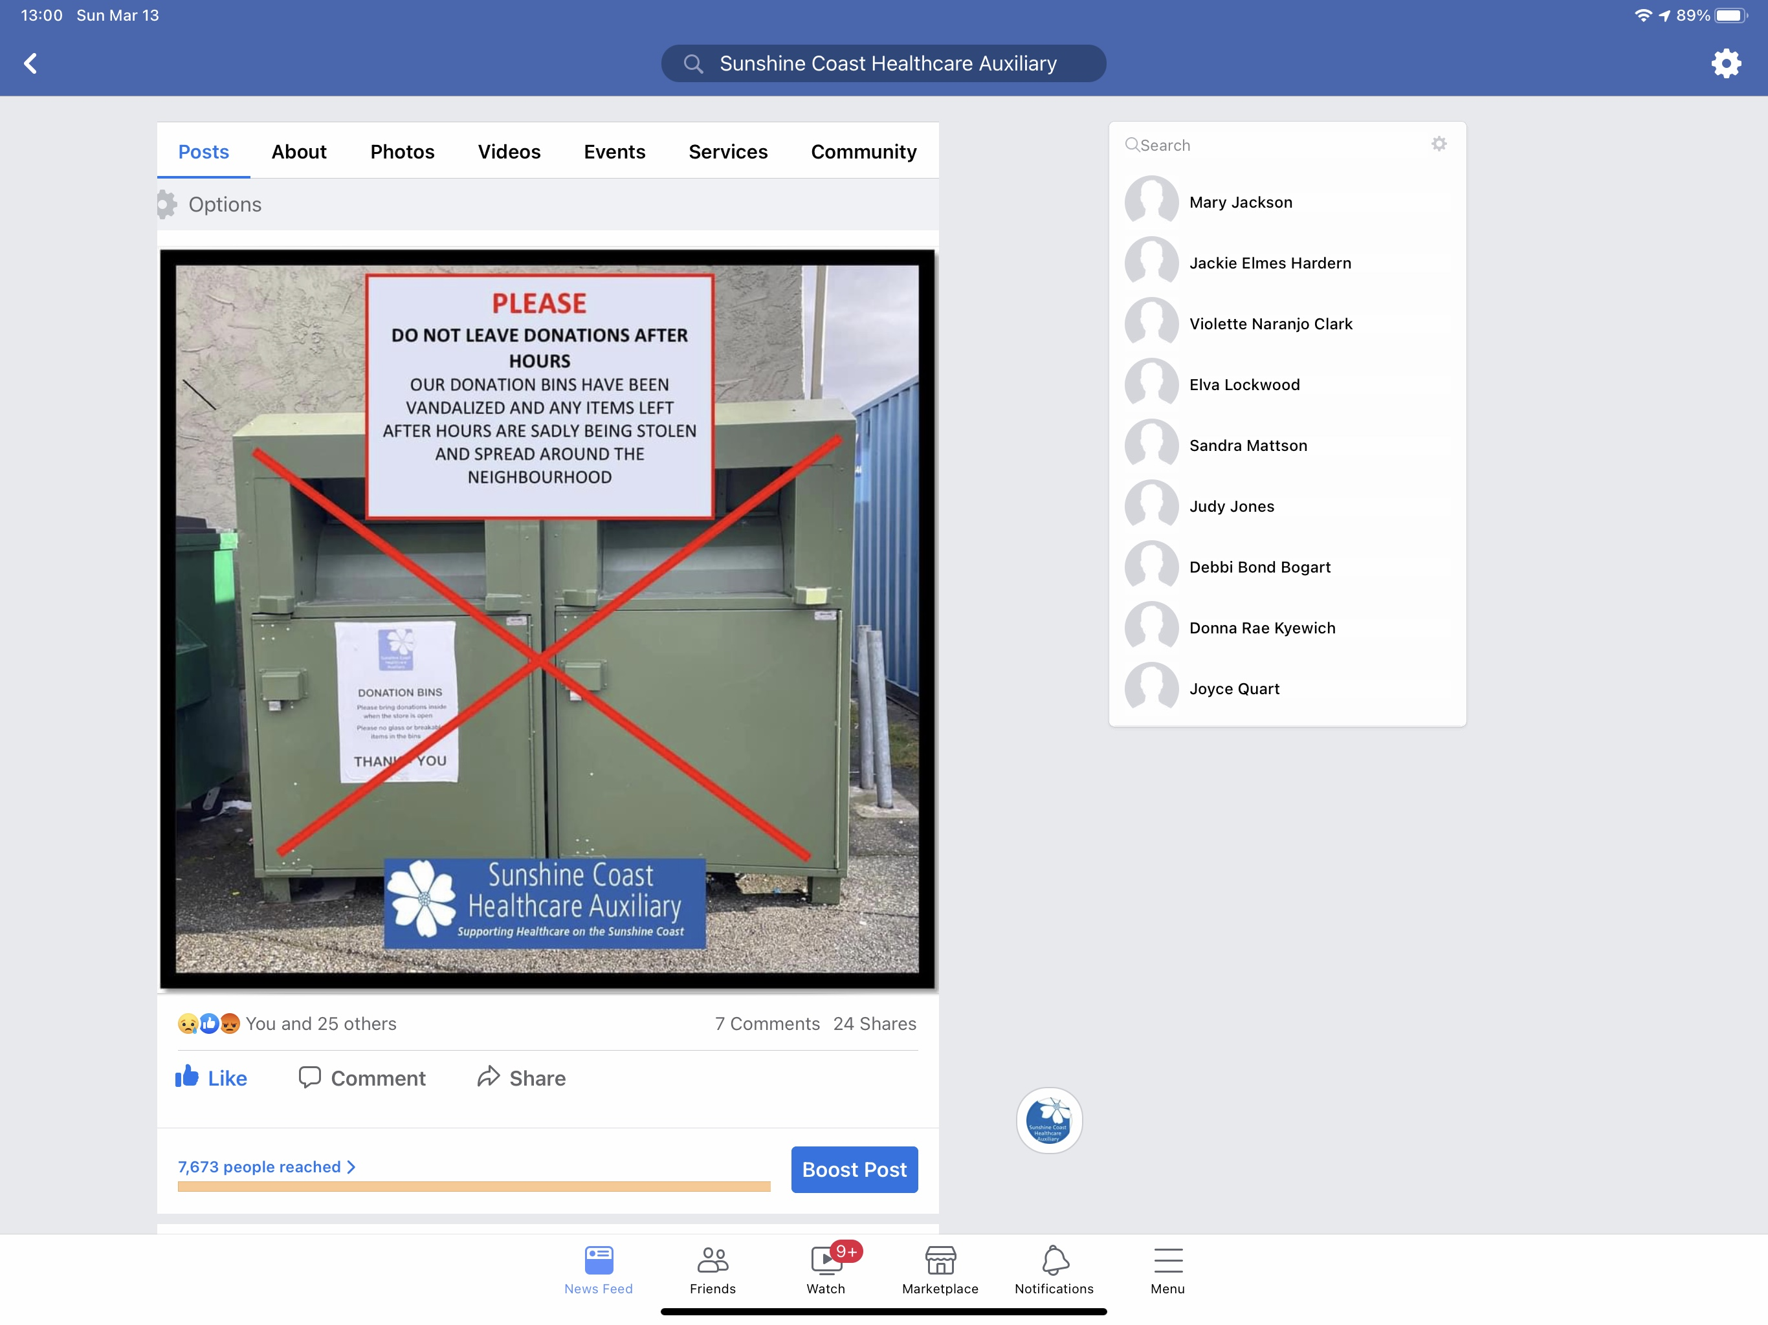
Upcoming Events and Difficult Conversations

Slide 18
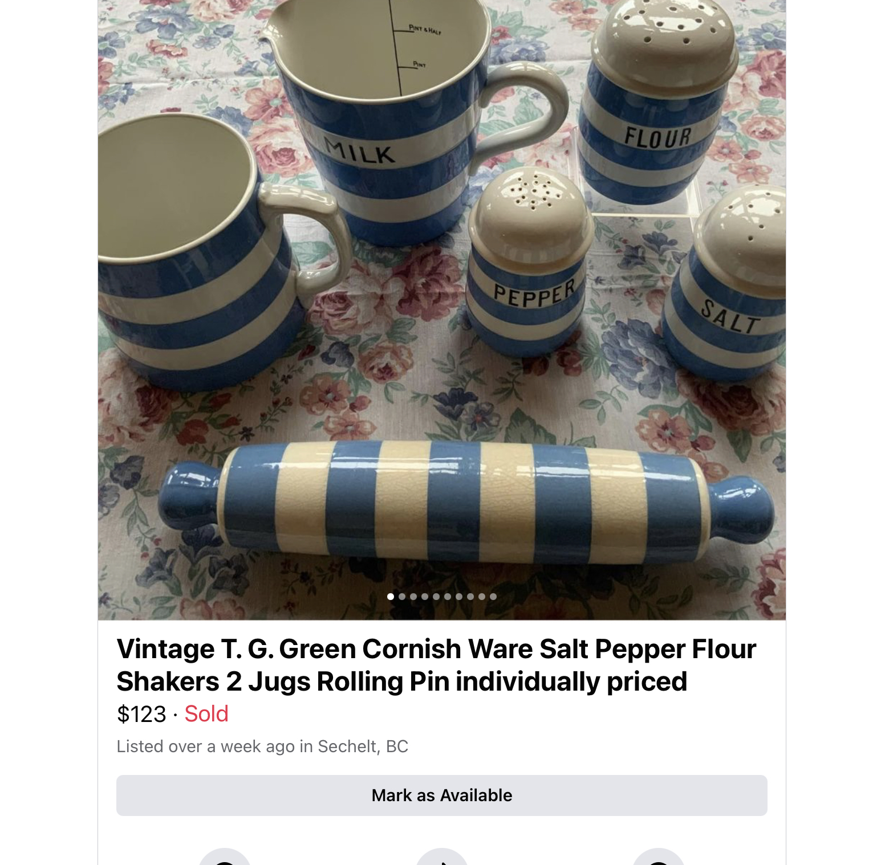
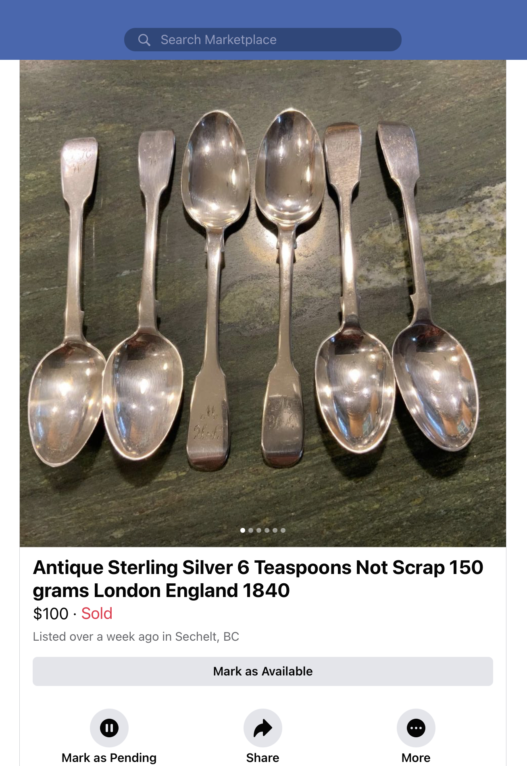
Selling Your More Expensive Treasures

Slide 19
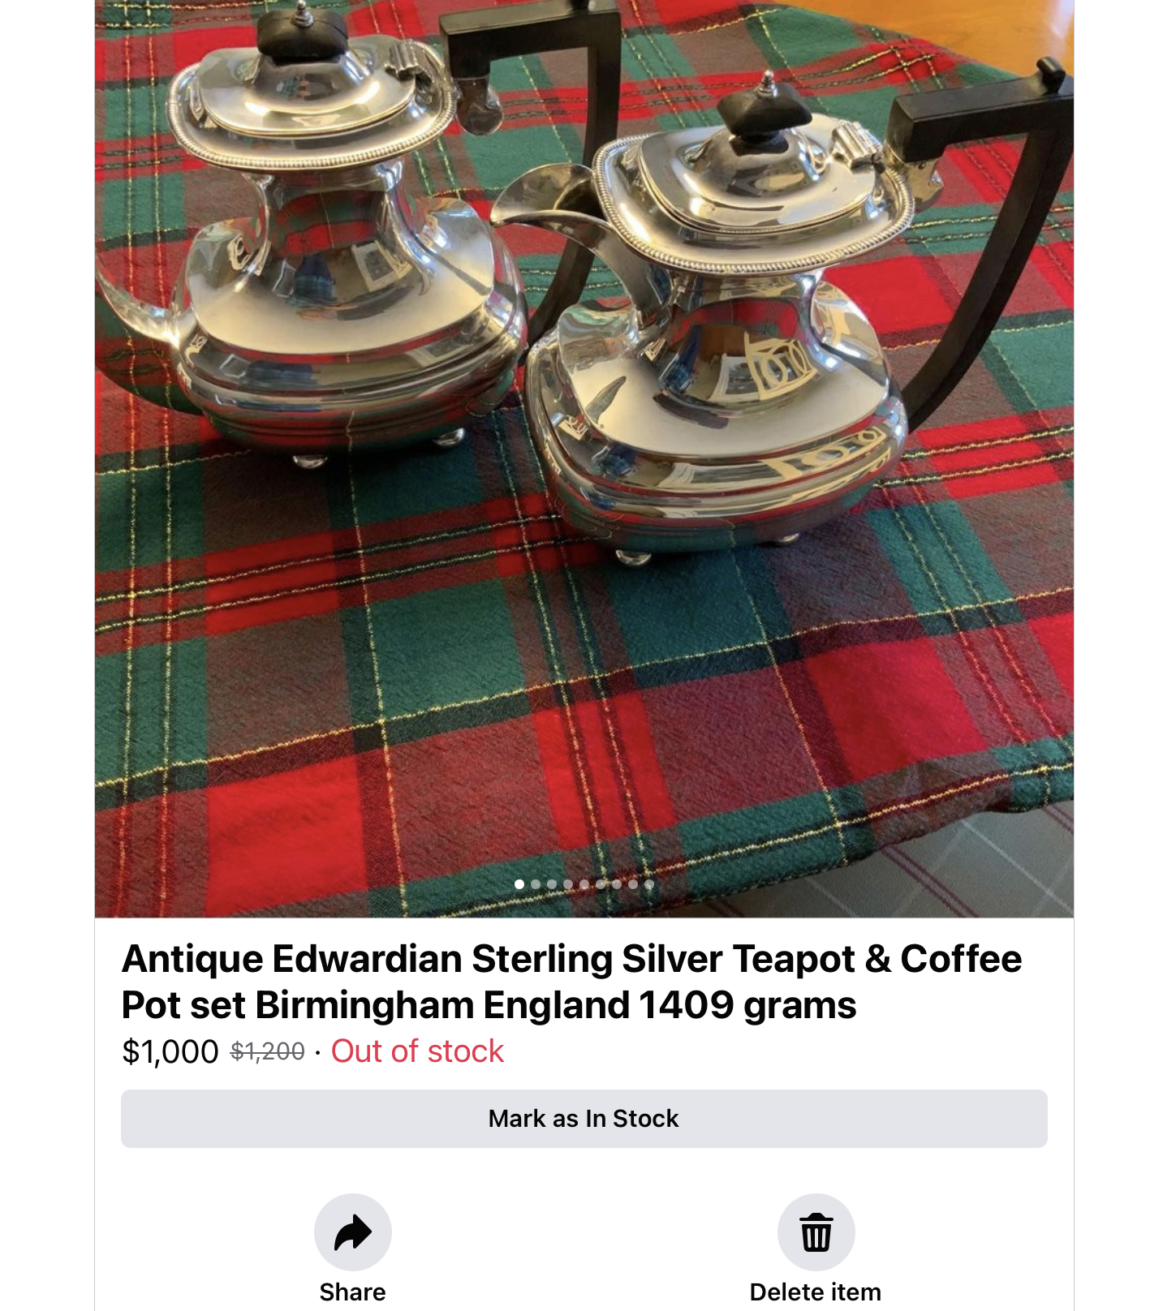
Our store has used Facebook Marketplace, EBay and Varage Sale

Slide 20
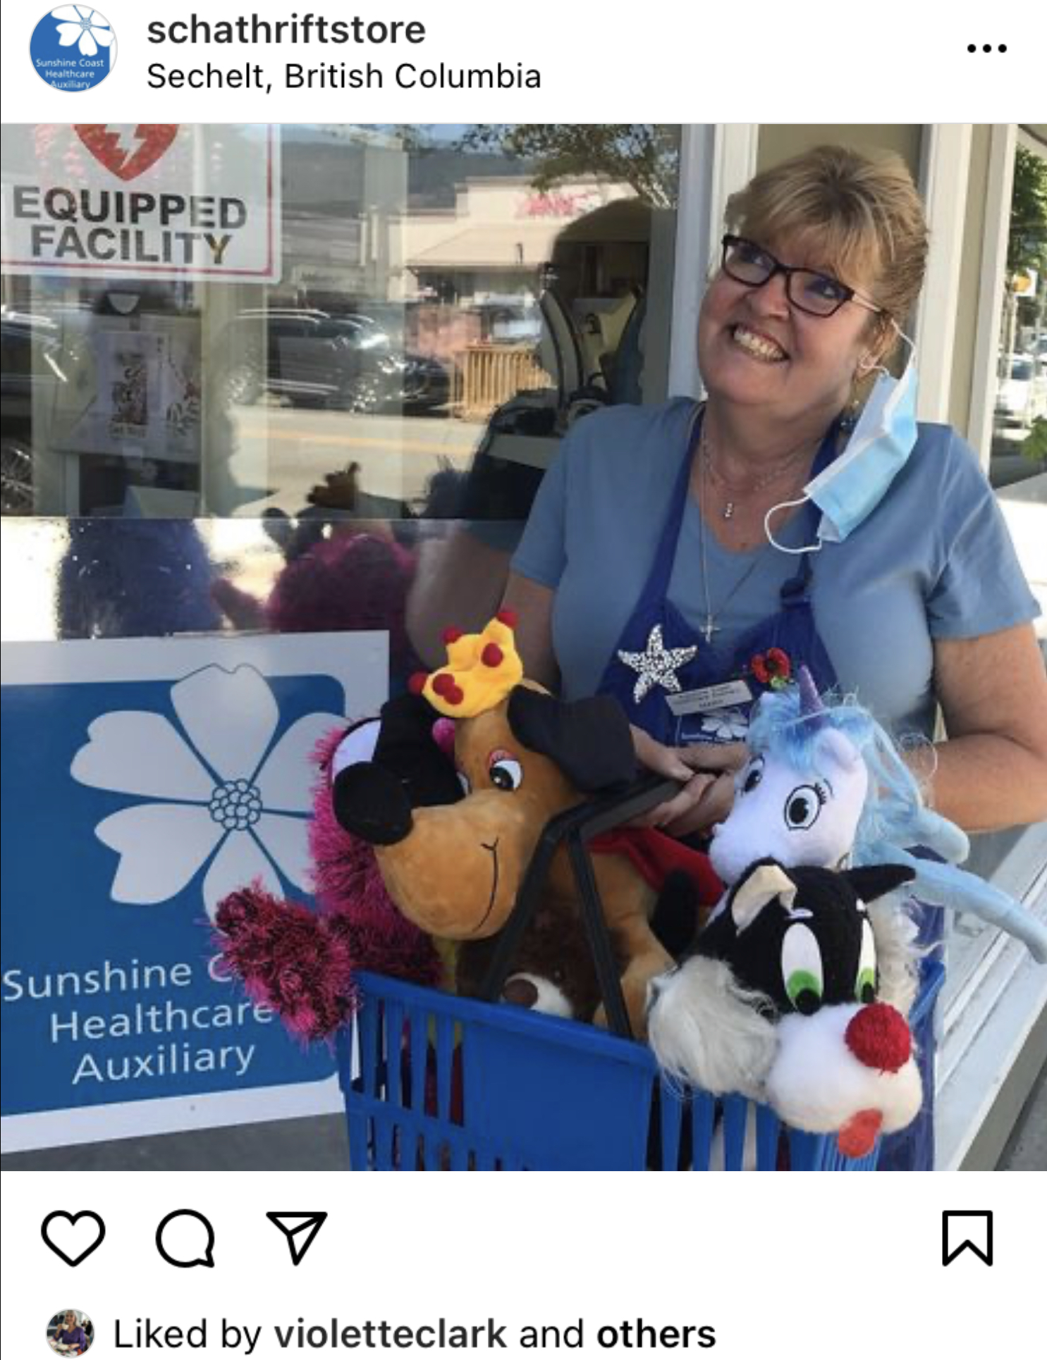
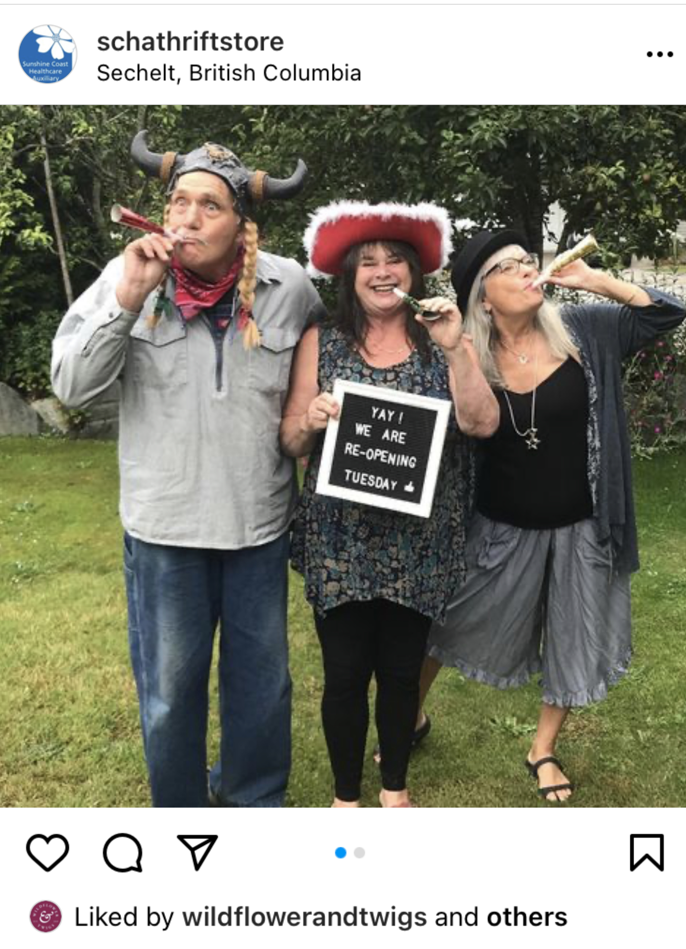
The best thing about Social Media?
It’s FREE!!
Be creative, have fun!

